Slide 1
4x4 – Last Four Edges
COLL 134
Week 11

Slide 2
F8E vs L4E
Where are paired edges stored?
F8E – space available on U and D layers
L4E – U and D layers are filled, must use B and F faces instead
Solution: Swap solved U/D edges with unsolved B edges before pairing

Slide 3
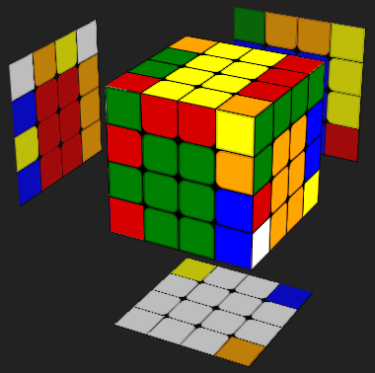
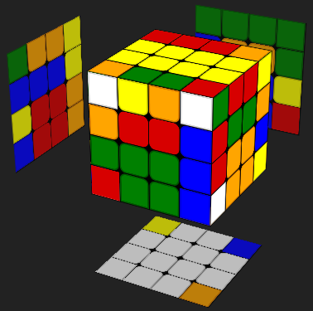
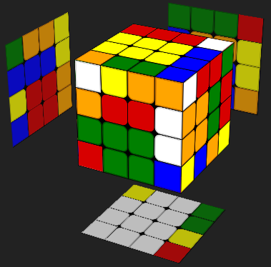
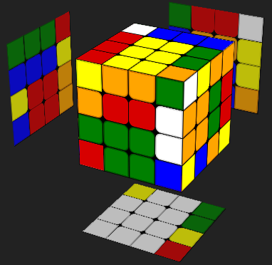
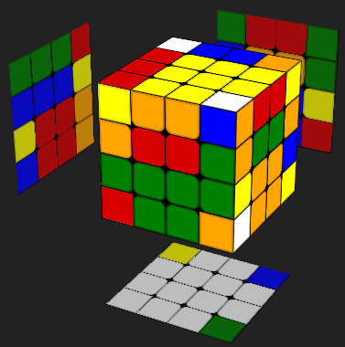
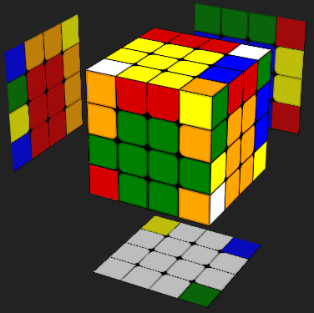
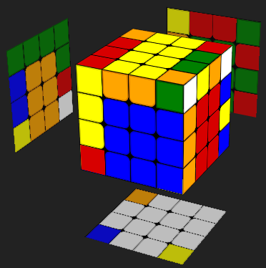
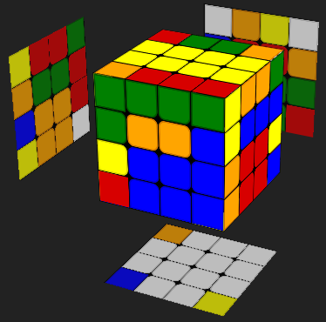
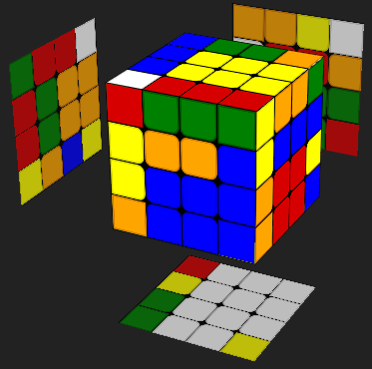
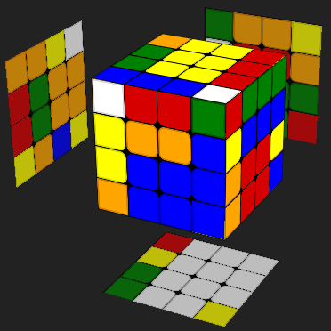
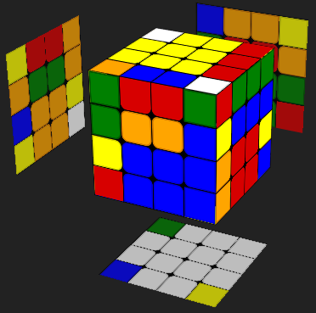
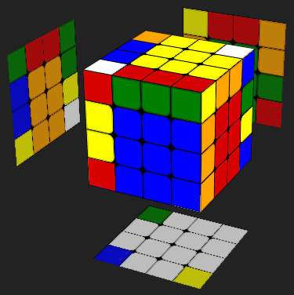
B Face Storage
Pairing moves preserve B edges
F
Uw’
R
U’
R’
Uw
B

Slide 4
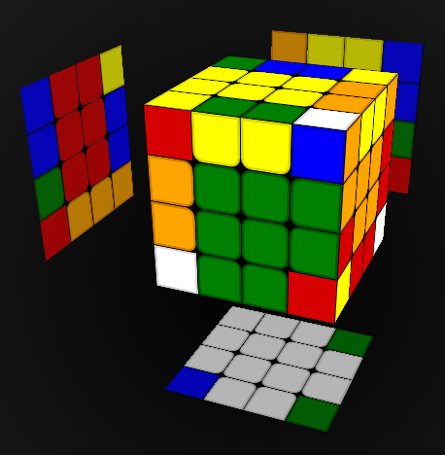
L4E Example
Pairing green-orange edge
D layer filled with white edges
U layer filled with yellow edges

Slide 5
L2E Algorithms (More Displacement)
adjacent orientation:
Slice -> Flip -> Reverse Slice
e.g. (Uw’) (R F’ U R’ F) (Uw)
diagonal orientation:
Flip -> Slice -> Flip -> Reverse Slice
e.g. (R F’ U R’ F) (Uw’) (R F’ U R’ F) (Uw)

Slide 6
Flipping Edges In Place
Two main options for flipping edges:
Long method: R U R’ F R’ F’ R
Short method: R F’ U R’ F
R’ can be omitted -> shortens to R F’ U F
Why can’t we just always use the short method?

Slide 7
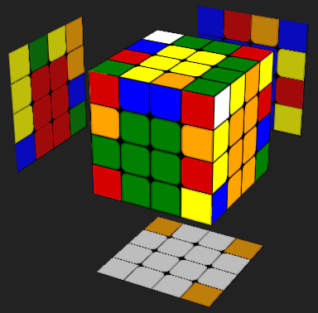
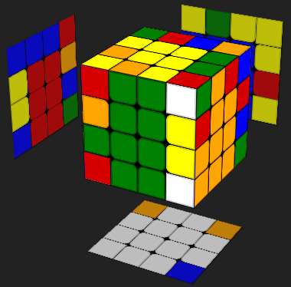
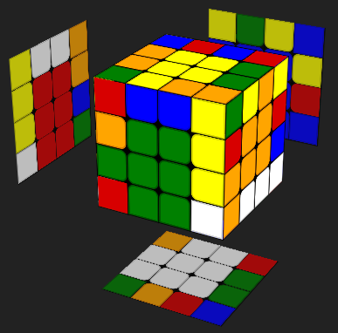
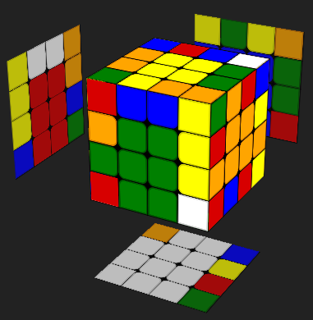
Edge flipped
Cross intact
Edge flipped
Cross affected
Edge flipped
Cross affected
R U R’ F R’ F’ R
R F’ U R’ F
R F’ U F

Slide 8
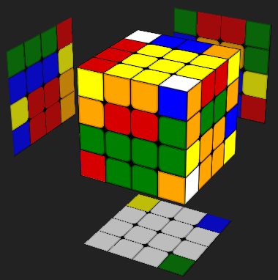
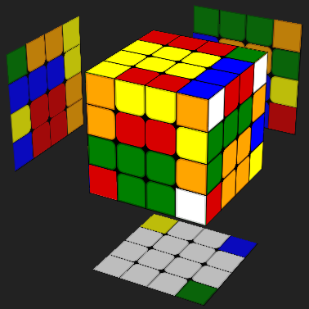
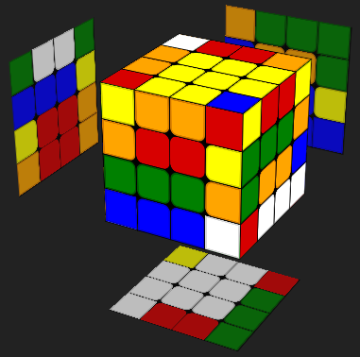
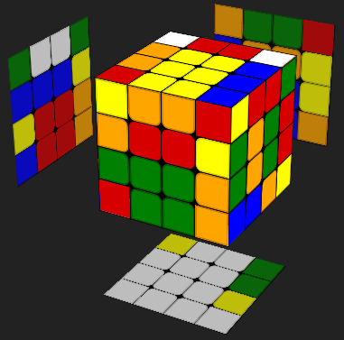
Edge flipped
Cross intact
Centers in line
Edge flipped
Cross affected
Centers in line
Edge flipped
Cross affected
Centers rotated
R U R’ F R’ F’ R
R F’ U R’ F
R F’ U F

Slide 9
3-2-3 Edge Pairing
Much faster way to pair edges than reduction or freeslice
Requires 4 edges to already be paired
Commonly used with Yau
Procedure:
Start with 4 edges already solved (typically white cross)
Pair 3 edges simultaneously -> 7 edges paired in total
Pair another 2 edges simultaneously -> 9 edges paired in total
Pair last 3 edges simultaneously -> all 12 edges paired

